Slide 1
Behavior change communication
EHS 215
Dissemination EHS 215

Slide 2
Introduction
The objective of the Dissemination Plan is to identify and organise the activities to be performed in order to promote the commercial exploitation of the project’s results and the widest dissemination of knowledge from the project.

Slide 3
What is Dissemination
“Dissemination means to spread widely
It can be defined as a Program that involves spreading the word about the project successes and outcomes as far as possible.”

Slide 4
Dissemination Plan Importance
The dissemination plan is aimed at being a comprehensive strategy with
a structured planning of dissemination activities
identification of target groups and key stakeholders at micro and macro level
channels of communication and timetable of activities

Slide 5
Dissemination Philosophy & Partner Embrace
The project consortium recognizes that dissemination and stakeholders’ engagement are central to the success of the project and are committed to contribute, each one according to its capacity and through its networks, in promoting the work that will be done as part of the project and in raising awareness on project contents and impacts

Slide 6
On Going Process
Whenever we speak of dissemination, we refer to activities that are designed to ensure that these results are appropriately recognized, demonstrated and implemented on a wide scale

Slide 7
Roles in Dissemination Process
LEAD PARTNER
Development of dissemination plan including channels and activities
Monitoring progress, planned results/deadlines and roles for dissemination
Developing dissemination tools, guidance and templates (e.g. reporting template, Word and PowerPoint template, project logo, Newsletters)
Providing support to partners with dissemination actions (e.g. organization of dissemination workshops)
PARTNERS
Disseminating about the project on their own website and through their own networks (local, regional, national and international level)
Writing news articles for the project website, for local media and on social media
Contributing to newsletter
Providing Dissemination Report (every 6 months), including evidence for dissemination activities

Slide 8
Dissemination Model – Practical Approach
A clear rationale for and objectives of dissemination and exploitation;
A strategy to identify which results to disseminate and to which audiences – and designing programs and initiatives accordingly;
Consider Differences; Determining organizational approaches of the different stakeholders and allocating responsibilities and resources;
Implementing the strategy by identifying and gathering results and undertaking dissemination and exploitation activities;
Monitoring and evaluating the effects of the activity.

Slide 9
Objectives
Disseminate information on the project overview and findings to the wider community, as well as to specific audiences.
Contribute knowledge in the research and practitioners communities.
Use the knowledge from the project to improve the quality of subject matter offered.
Achieve stakeholder and institutional buy-in
Create a sense of ownership among the widest cross-section of stakeholders during the project life-cycle

Slide 10
Aims of Dissemination
Raise awareness
Extend the impact
Engage stakeholders and target groups
Share solutions and know how
Influence policy and practice
Develop new partnerships

Slide 11
Ten Elements of an Effective Dissemination Plan
After you have developed your dissemination policy statements, you are ready to turn your attention to more specific dissemination planning. Remember that your dissemination planning should start at the beginning of your research activities, not at the end. This approach will allow you to meet your dissemination challenge in a timely manner

Slide 12
Cont’
Goals: Determine and document the goals of your dissemination effort for your proposed project.
Objectives: Associate each goal with one or more objectives that clarifies what you are trying to accomplish through your dissemination activities.
Users: Describe the scope and characteristics of the "potential users" that your dissemination activities are designed to reach for each of your objectives.

Slide 13
Cont’
Content: Identify, at least, the basic elements of the projected content you have to disseminate to each of the potential user groups identified.
Source(s): Identify the primary source or sources that each potential user group is already tied into or most respects as an information source. Consider ways to partner with these sources in your dissemination efforts

Slide 14
Cont’
Medium: Describe the medium or media through which the content of your message can best be best delivered to your potential users and describe the capabilities and resources that will be required of potential users to access the content for each medium to be used.
Success: Describe how you will know if your dissemination activities have been successful. If data is to be gathered, describe how, when, and who will gather it.

Slide 15
Cont’
Access: Describe how you will promote access to your information and how you will archive information that may be requested at a later date. Consider that most people will use your project-related information when they perceive a need for it – not necessarily when you have completed your research project.
Availability: Identify strategies for promoting awareness of the availability of your research-based information and the availability of alternate available formats.

Slide 16
Cont’
Barriers: Identify potential barriers that may interfere with the targeted users’ access or utilization of your information and develop actions to reduce these barriers.

Slide 17
Challenges Related to Dissemination
User Groups
Limited user readiness to change
Widely divergent format and level of information needed
Multiple levels of contextual information needed
Less than clear relevance to own needs
Variety of dissemination media preferred
Limited number of information sources trusted

Slide 18
CONT’
Source
Low level of perceived competence
Limited credibility of experience
Suspicion regarding motive
Lack of sensitivity to user concerns
Limited relationships to other sources trusted by users

Slide 19
Content
Low confidence in quality of research and development methodology
Limited credibility of outcomes
Restricted comprehensiveness of outcomes
Unclear utility and relevance for users
Non-user friendly format
Costs or equipment required to access
Lack of statistical power in research design, procedures, and data analyses

Slide 20
Cont’
Context
Limited applicability to current issues in the field
Competing knowledge or products
General economic climate and circumstances
Lack of relationship between outcomes and existing personal knowledge or products

Slide 21
Cont’
Medium
Limited physical capacity to reach intended users
Long timeframes required to access
Unclear accessibility and ease of use
Lack of flexibility
Limited reliability
Cost effectiveness
Limited clarity and attractiveness of the information "package

Slide 22
Dissemination Baseline Activities
Dissemination Plan
Web Portal
Project Leaflet
Project Logo
Social Media
Printed Media
Audio/Video Production
Dissemination Monitoring tools

Slide 23
Cont’
conferences,
workshops,
academic courses,
meetings,
computer-based discussion lists, and
products, such as:
reports,
journal articles,
newsletters, and
websites

Slide 24
Dissemination Activities (example)
Distribution of 1000 project leaflets (200 per partner)
24 press releases/3 press releases per partner
96 news items to be published to the portal/12 news items per partner
3 Social Media pages (i.e. Facebook, Twitter, You Tube).
1 Video will be developed and will be available online
Presentations of the project and its activities at 10 conferences (2 per partner)
Share project outputs via the project website
Visit stakeholders and institutions and disseminate project activities
Dissemination of the project via mainstream media (TV, radio, newspapers, thematic magazines)
Secure 20,000 visits to the online platform

Slide 25
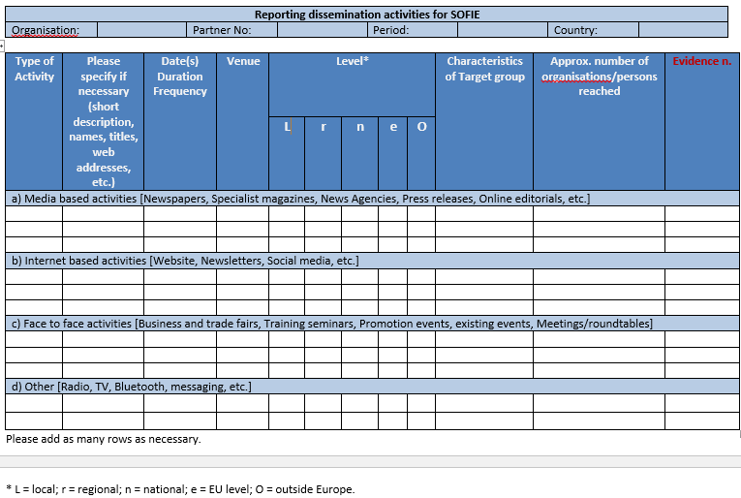
Time plan of Upcoming Activities
What | Who | When
Project Logo | Partner A | End of march 2019
Dissemination Plan (draft version) | Partner B | First week of Aprill 2019
Dissemination Plan plus Tools (Final version) | Partner C | June 15 2019
Creation and set-up of project website and social media page(s) | Partner D | July 25 2019
1st Newsletter | Partner E & all partners | Semptember 30 2019
1st Dissemination Reporting | All partners | November 15 2019

Slide 26
Basic Dissemination Admin Rules
In all documents related to the project always use the logo of the project, the Erasmus + logo and the EU disclaimer available at: http://ec.europa.eu/dgs/education_culture/publ/identity_en.htm
Inform all partners of any dissemination and visibility activity, at least one week prior the event.
Provide a short report upon the implementation of any activity for dissemination and visibility purposes within one week from the completion of the activity.
Update the dissemination log.
Network the project as widely as possible.
All partners should provide news items by set dates (preferably every month) in order to secure an updated and active portal

Slide 27
Multiplier Events (Example)
2 Seminars per partner country
Each event will be attended by a minimum of 20 persons (2X5X20 = 200)
Targeting adult training providers, networks, local communities representatives, youth organizations, public servants, academics, civil society organizations
European Sustainability and Multiplication Conference

Slide 28
Supporting documents for Multiplier events
Proof that the event has taken place and is of acceptable quality - description in the final report
Invitation to and programme of the event
Detailed agenda of the event and any documents used or distributed at the event
Pictures/Video
Signed attendance list with name, date and place of the event and for each participant:
Name
Email address
Signature of the participant
Name and address of the sending organisation of the person

Slide 29
Project Lasting Effects
Cooperation in planning and communication in all fields where youth is engaged between the different countries of Europe
The exchange of good practices between network partners
The best use of results and the innovative project final product through the creation of online tools that would be sustained
New forms of information literacy in order to stimulate active participation in modern society
Adequate field learning and the provision of associated values, attitudes and behaviors in youth adult groups
The strengthening of ties between young adult learning

Slide 30
Sustainability
Keys to future sustainability:
Encouraging adult training providers and education institutions to promote the project to young adults;
Engaging an increasing number of civil society organizations, adult learning providers, policy makers, public services and EU citizens.
Establishing, formalizing and growing these arrangements will be critical to sustained success
Project to be integrated in the training activities of at least 10 training providers in each partner country by the end of the project

Slide 31
Dissemination Monitoring Tools
Dissemination Log
Activities Description
Rubrics
Collecting Numbers
Proof Collection and Filing
Pictures, Video, Signatures
Stakeholder’s Contribution
What was covered by which partner

Slide 32
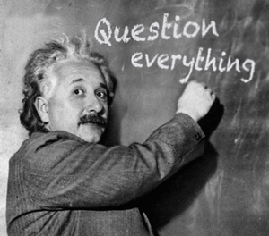

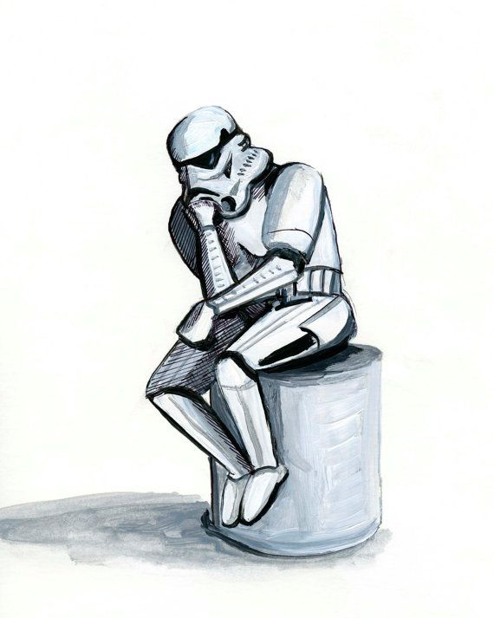


Questions? Comments thus far?
Notes:
Do we have a graphic. Cartoon..something to indicate questions- someone raising hand; Rodin thinkng statue, interacting students in classroom?
Some ideas

Slide 33
Thanks

